Slide 1
Learning to Aggregate on Structured Data
Master Thesis Final Presentation
Clemens Damke

Slide 2
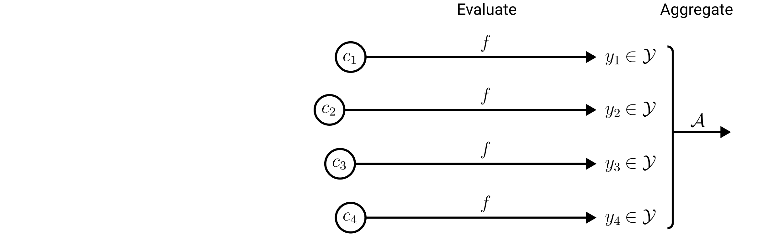
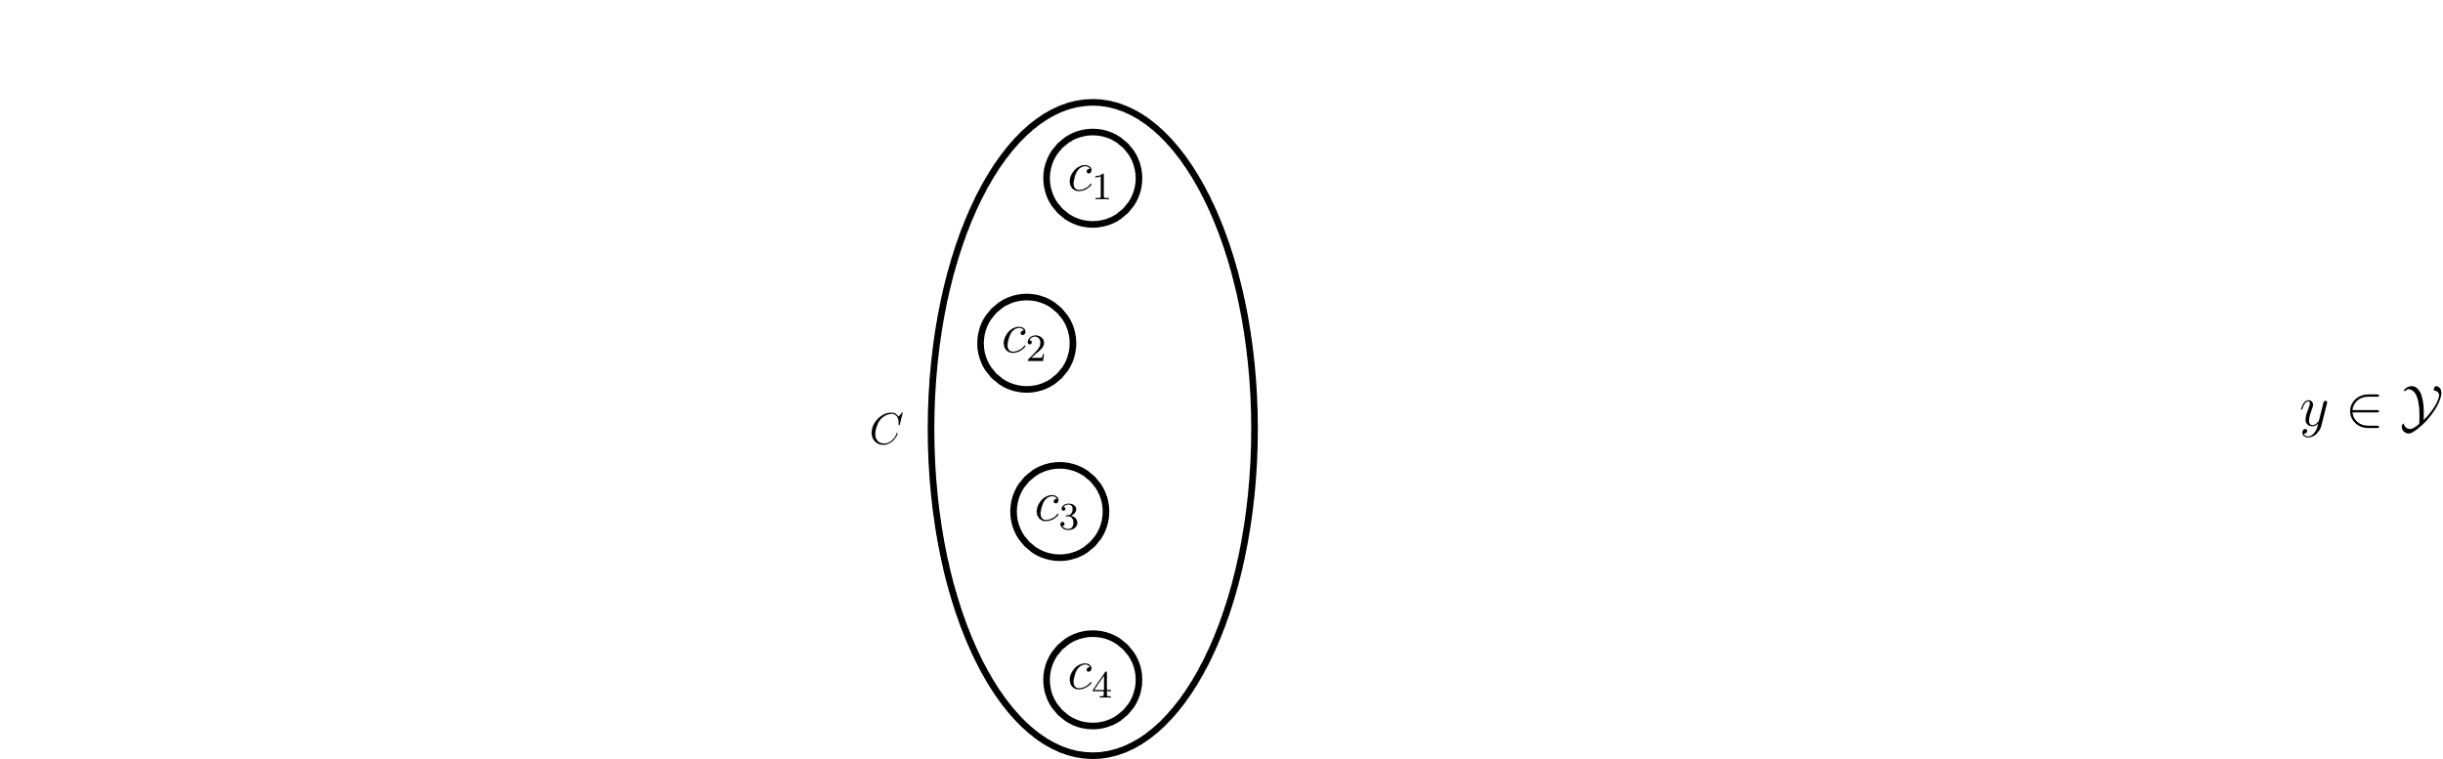
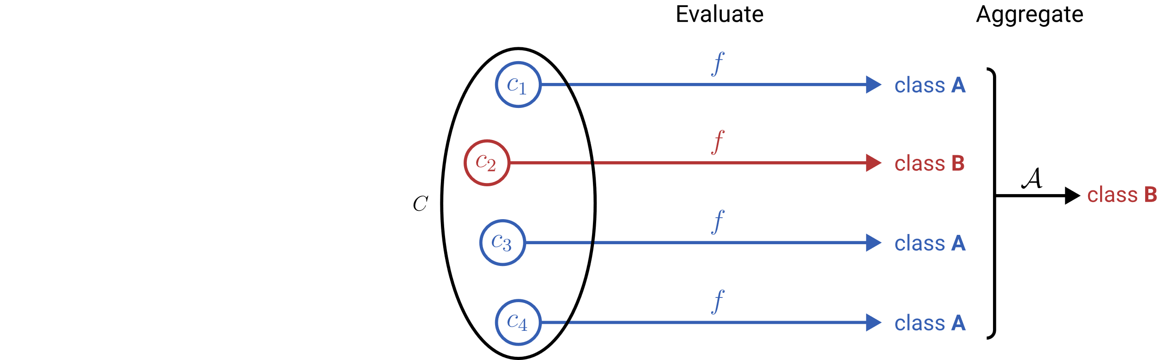
Learning to Aggregate on Unstructured Data
Permutation invariance
Variable input size
Localized explainability
composition
constituent

Slide 3
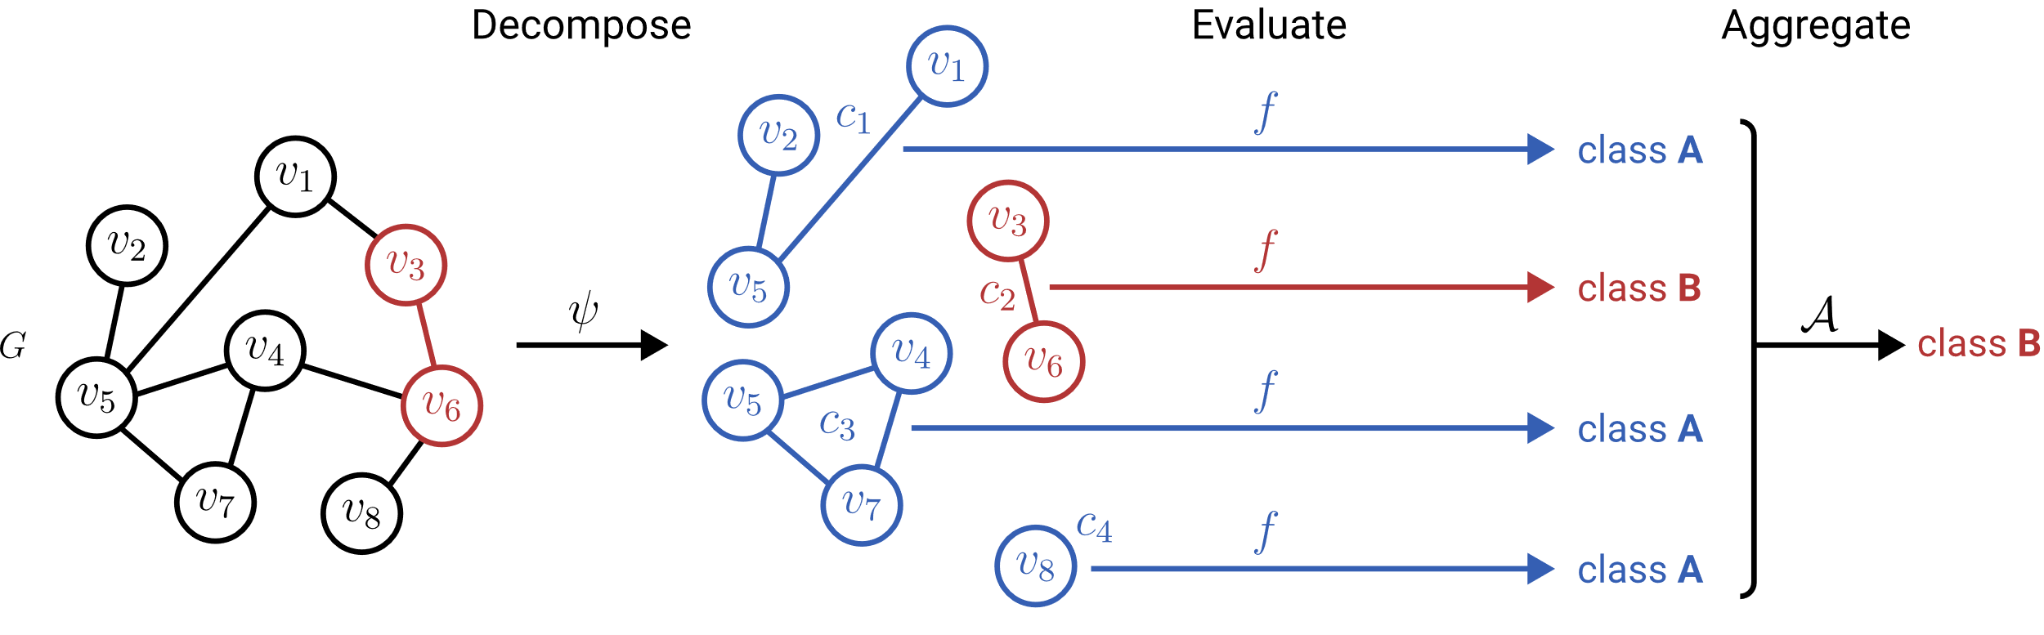
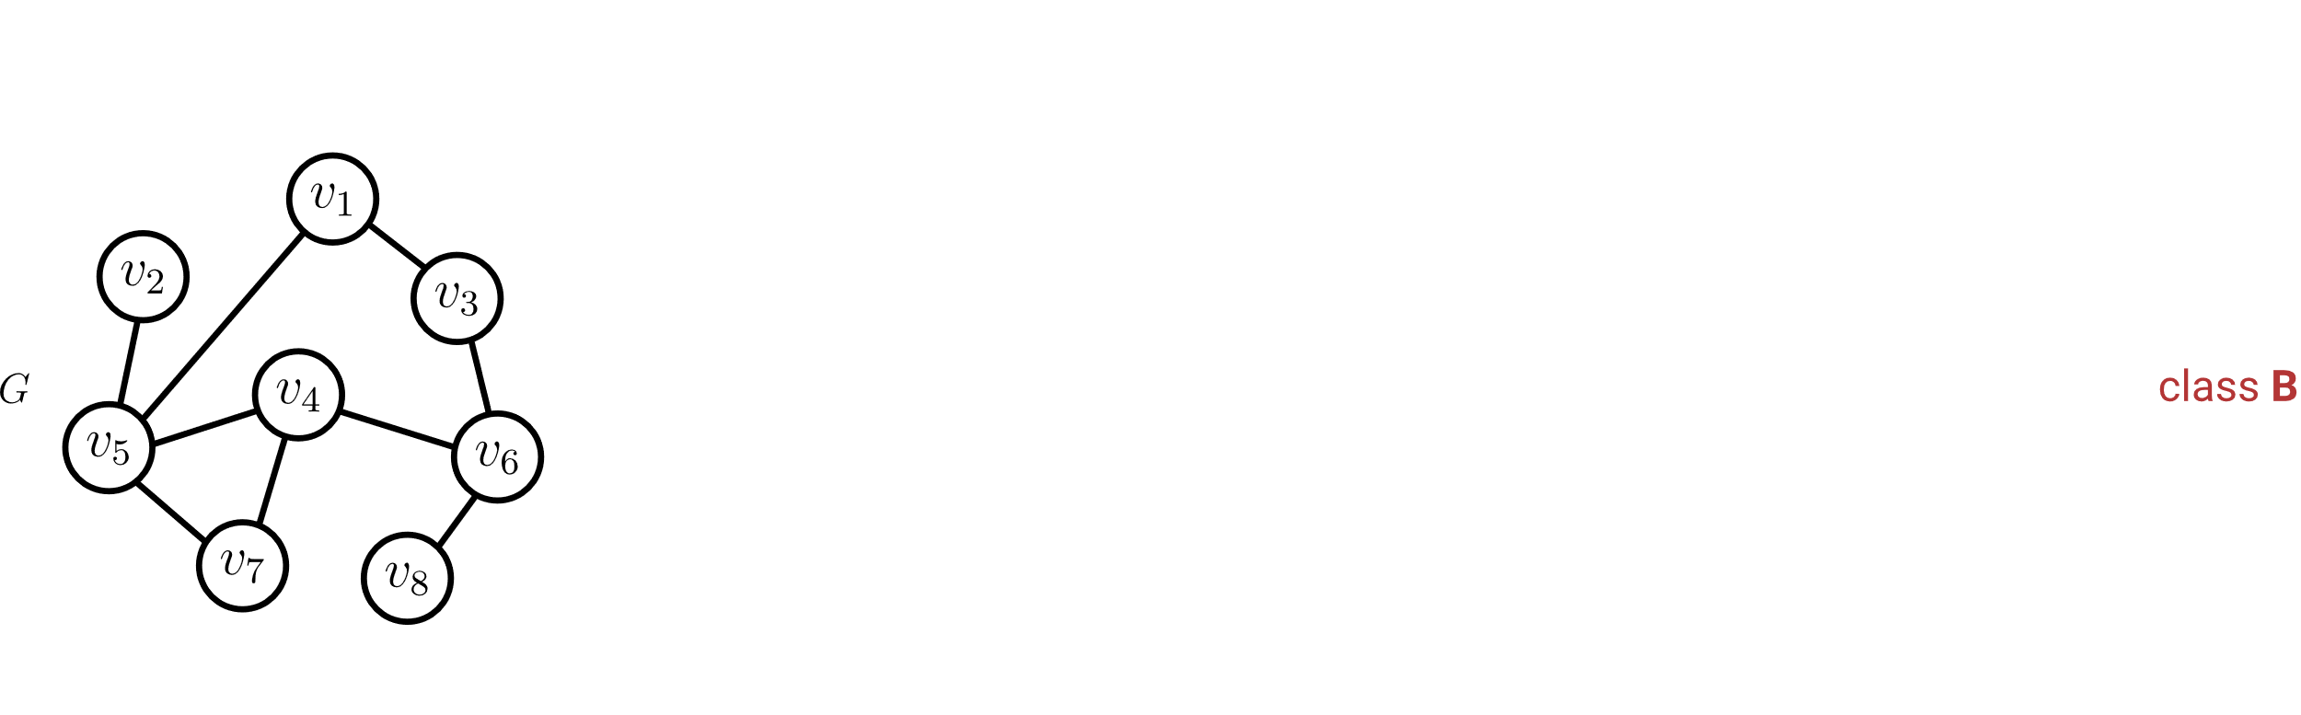
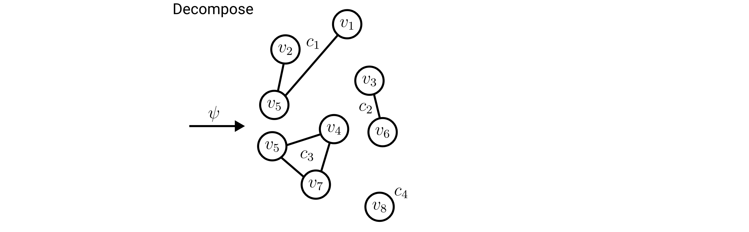
Learning to Aggregate on Structured Data
Permutation invariance
Variable input size
Localized explainability

Slide 4
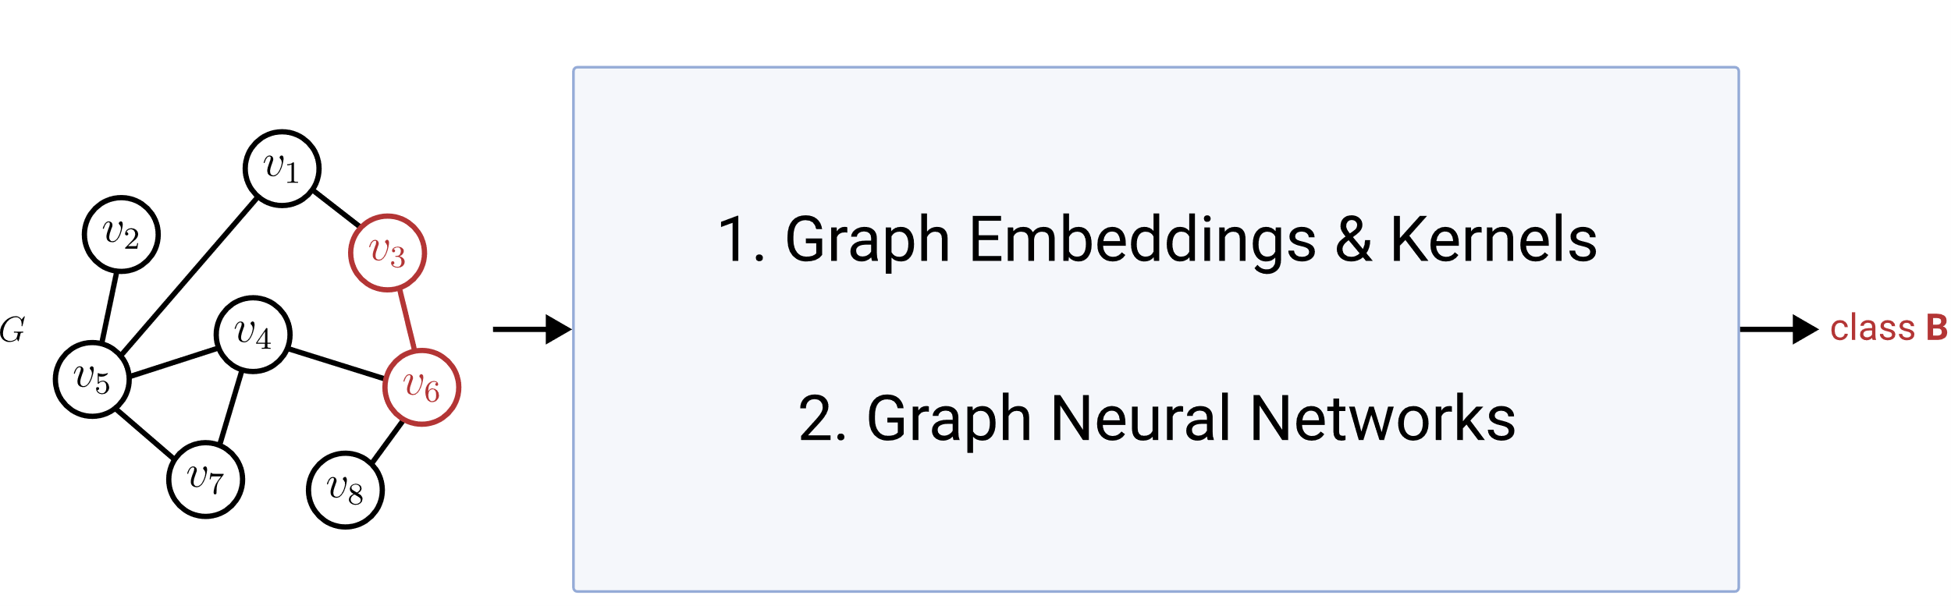
Graph Classification & Regression (GC/GR)
Permutation invariance
Variable input size
Localized explainability
ü
ü
?

Slide 5
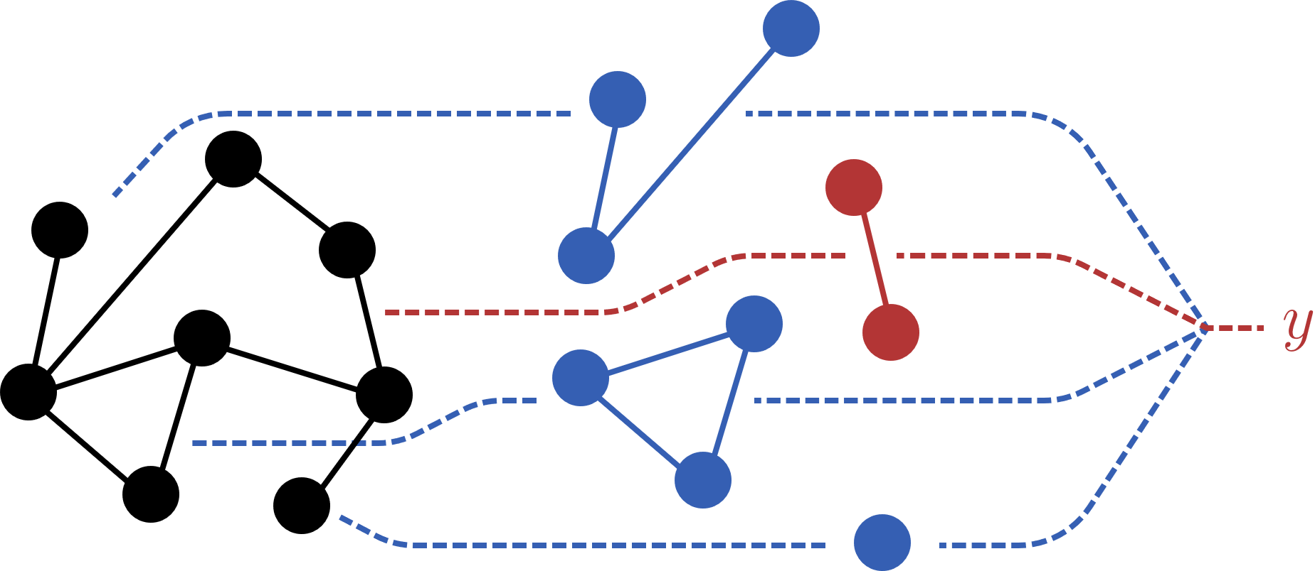
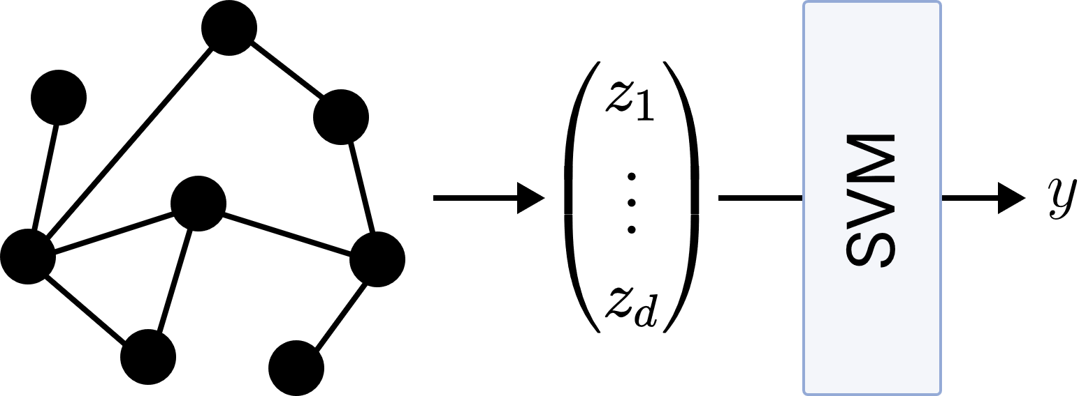
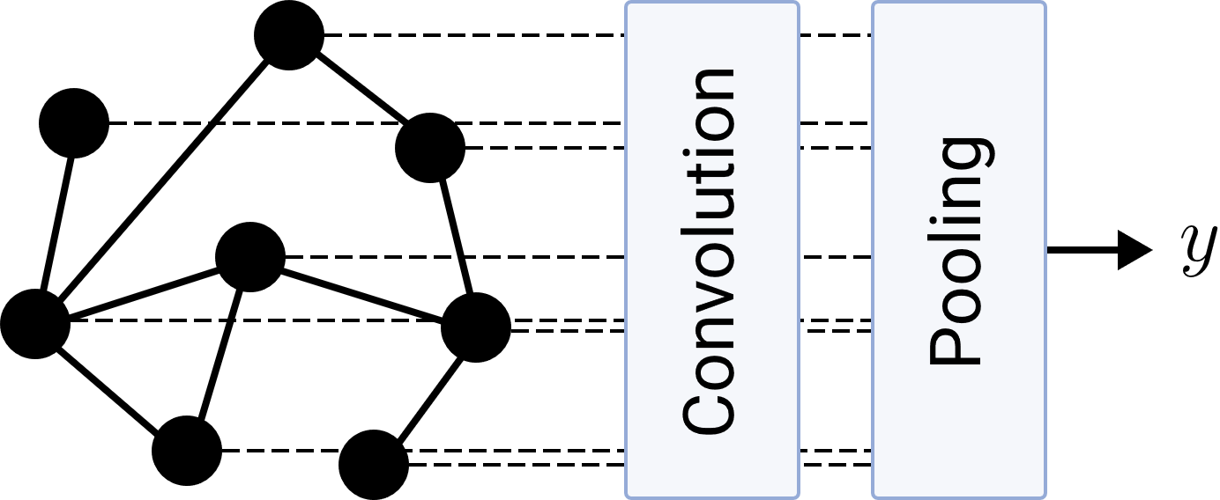
Research Questions
LTA
What is a general definition of LTA?
How does LTA relate to existing GC/GR methods?
What are shortcomings of existing GC/GR methods? How can they be fixed?
Graph Embeddings & Kernels
Graph Neural Networks

Slide 6
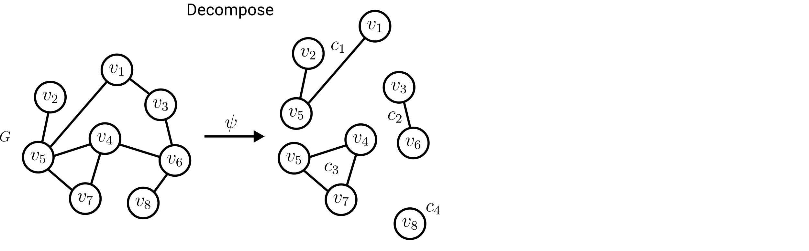

Definition of LTA: Decomposition
Ideally: Localized, interpretable subgraph constituents.
Required:
Split a graph into a subset of its subgraphs.

Slide 7
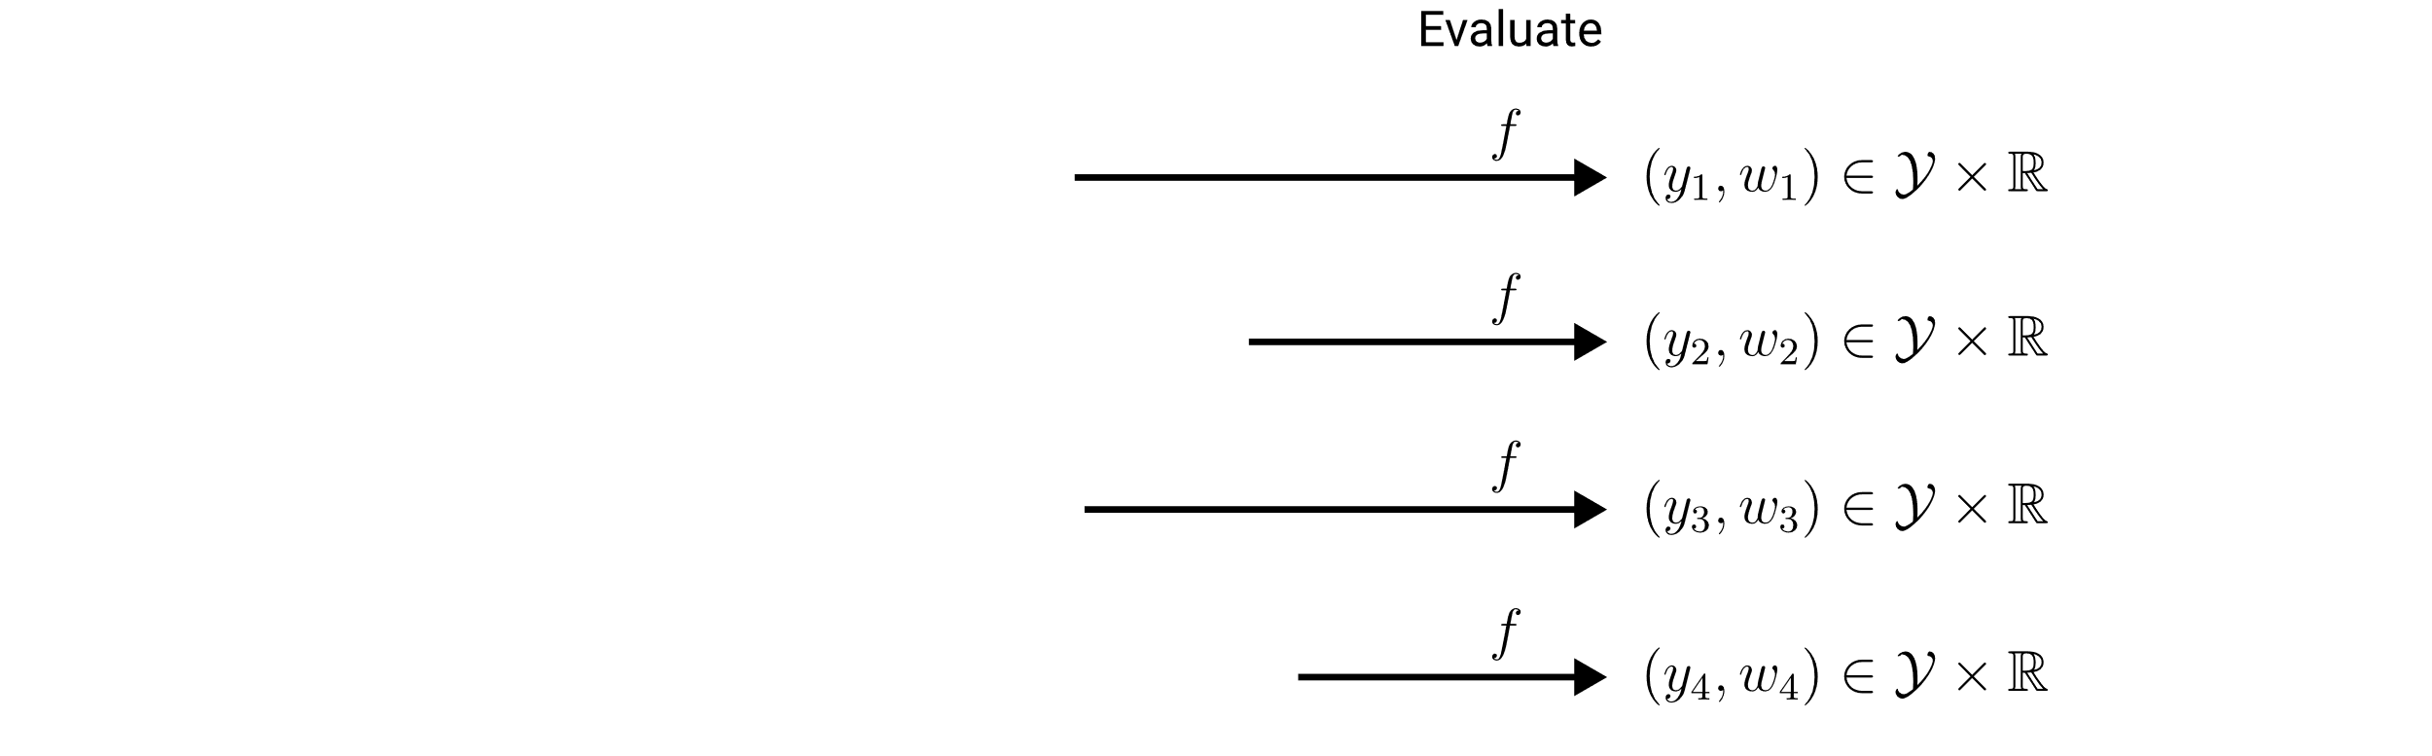
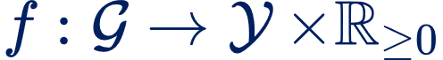
Definition of LTA: Evaluation
Importance for the composition score.
Required:
Assign a score and weight to each constituent.

Slide 8

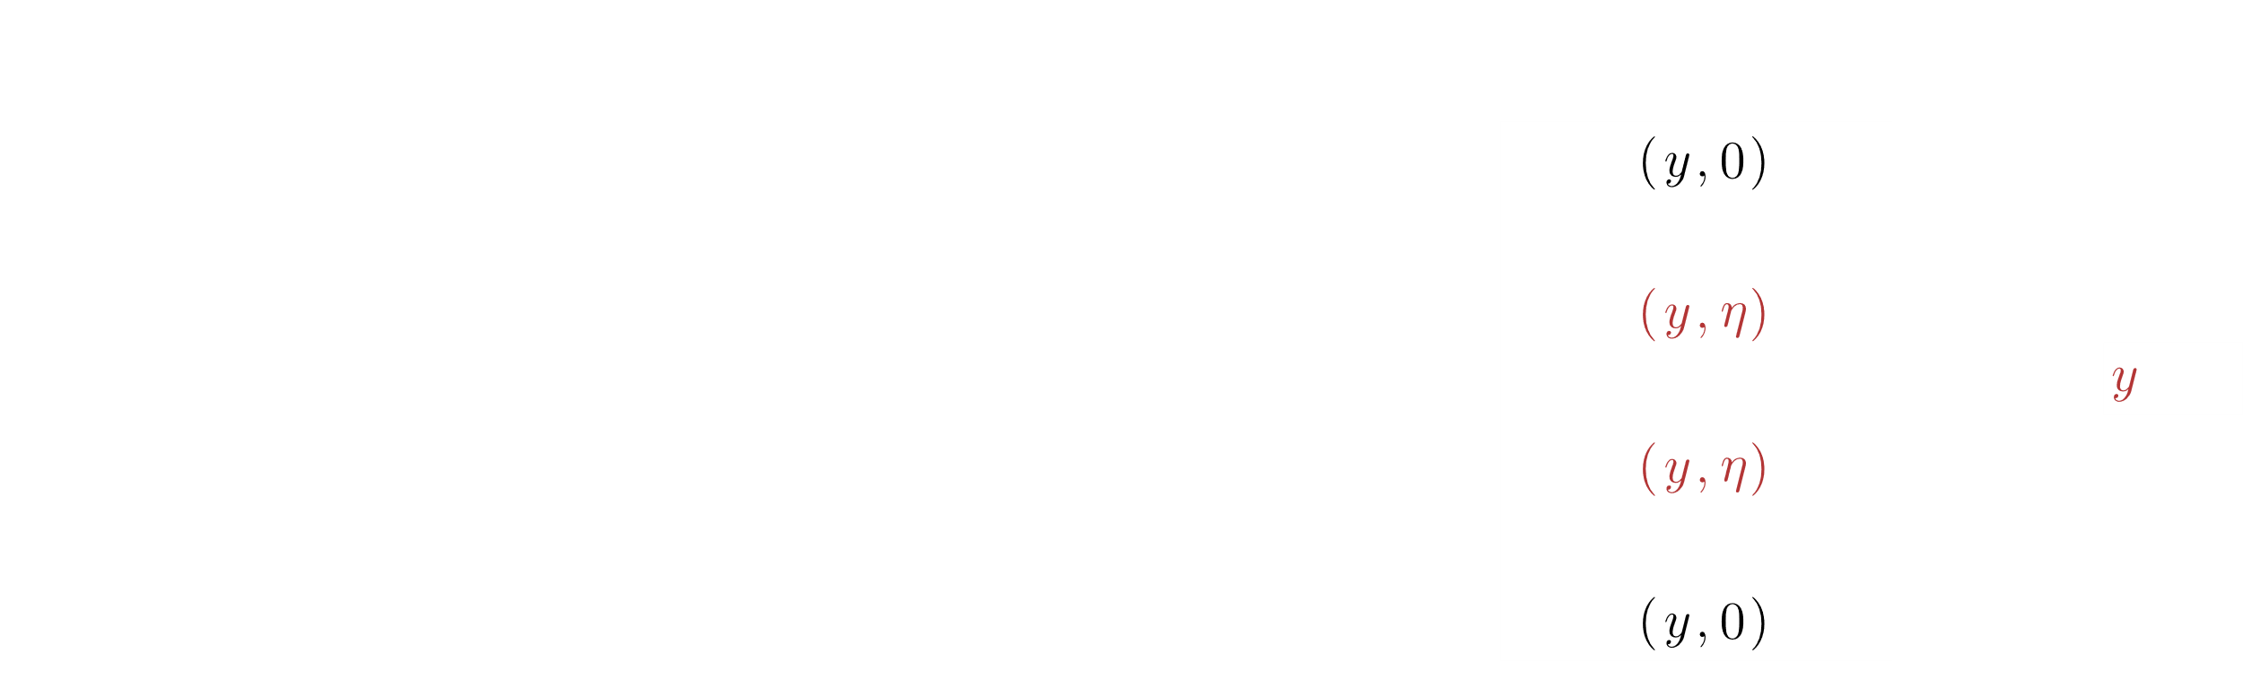
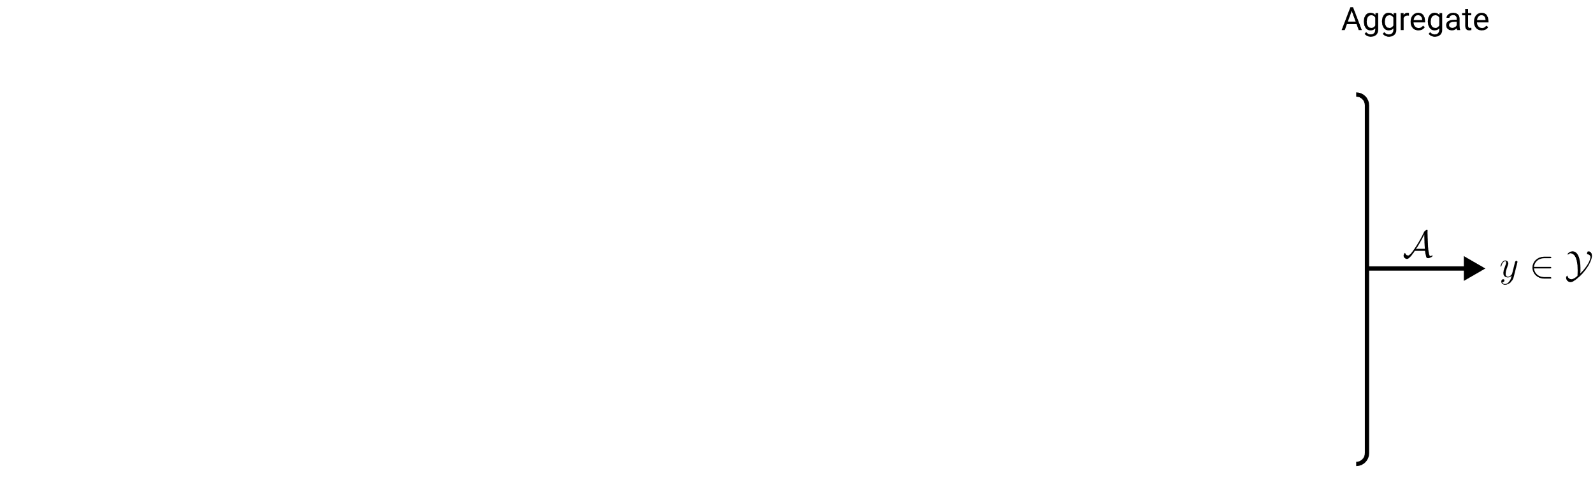
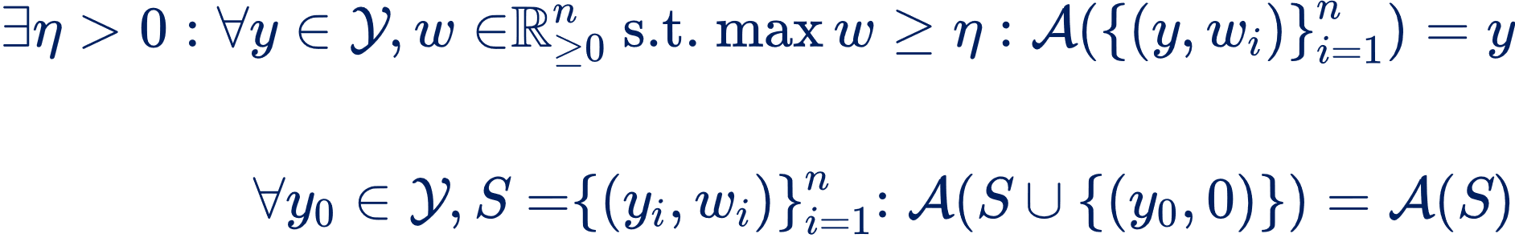
Definition of LTA: Aggregation
Idempotency:
Zero invariance:

Slide 9
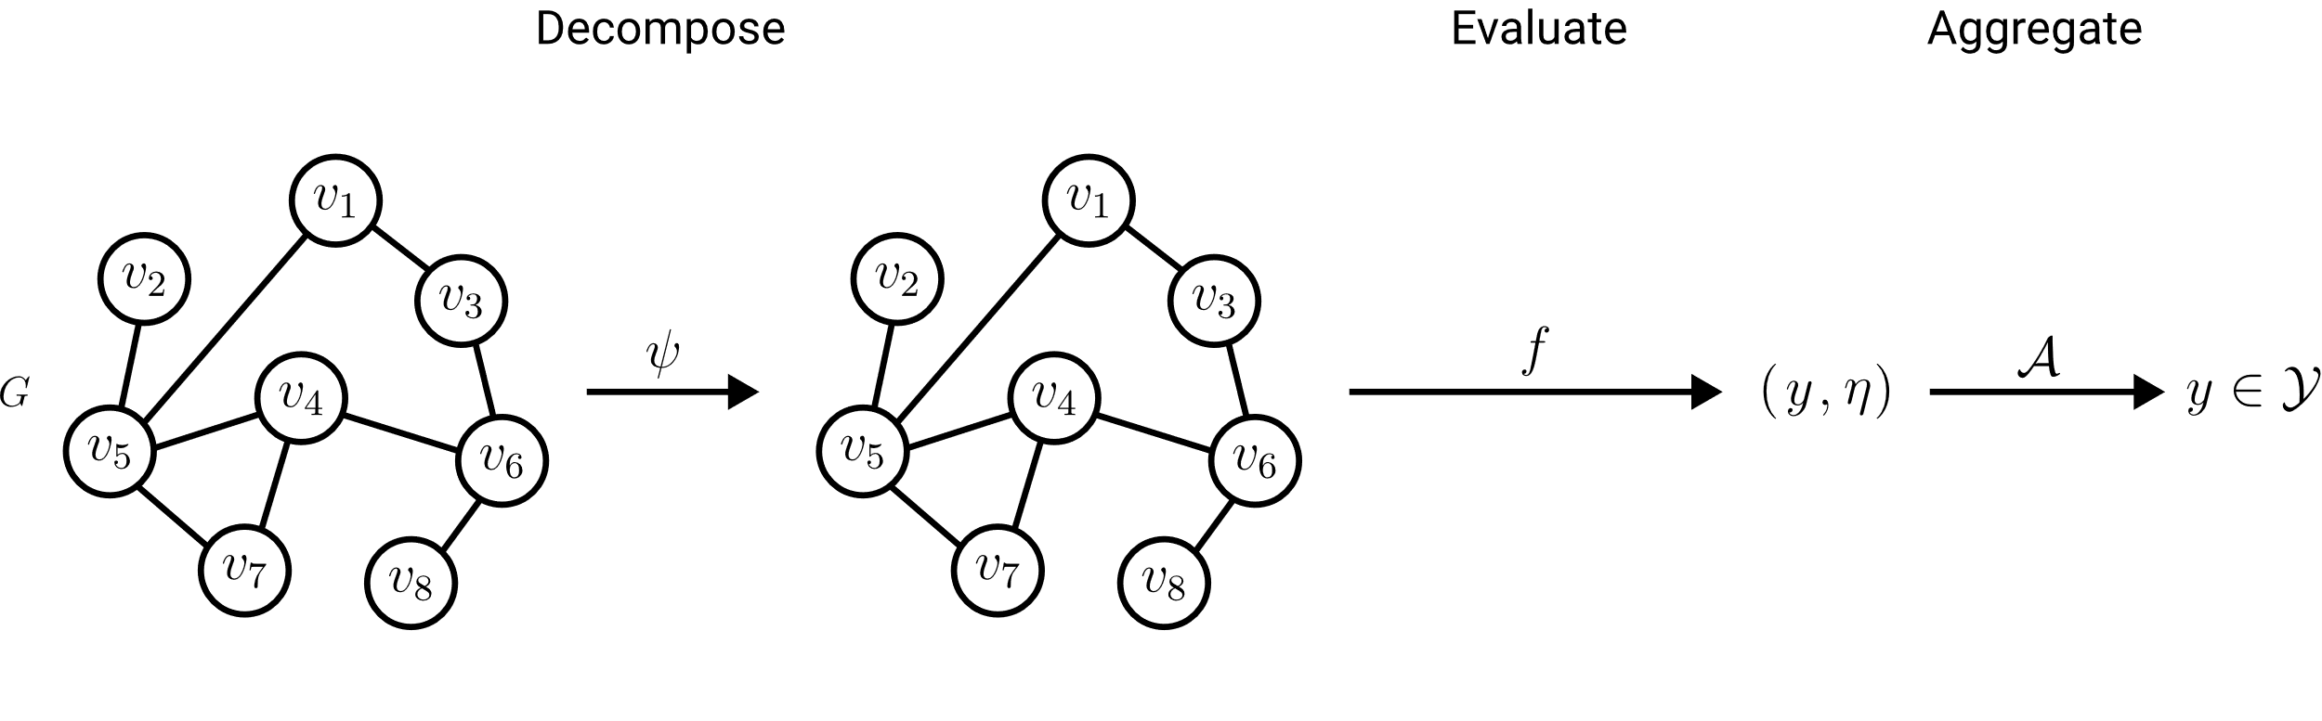

Definition of LTA: Formulations
Trivial decomposition
LTA Formulation

Slide 10
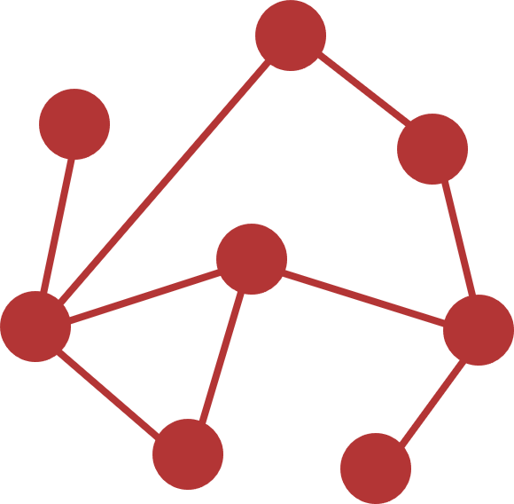

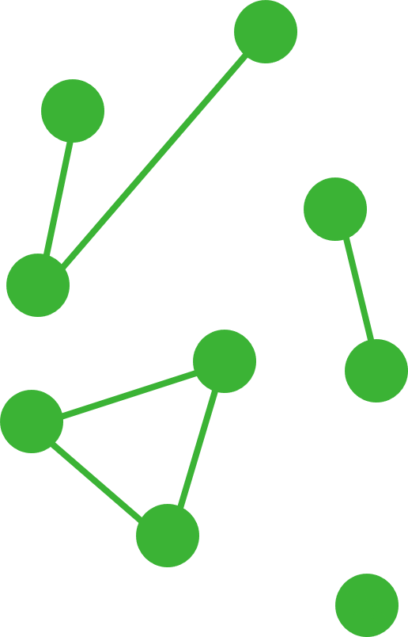
Definition of LTA: LTA vs non-LTA
non-LTA
One trivial global constituent
LTA-like
Connected component constituents
Localized Explainability
LTA-like
Localized constituents of limited size
LTA
Meaningful localized constituents

Slide 11
Research Questions
LTA
What is a general definition of LTA?
How does LTA relate to existing GC/GR methods?
What are shortcomings of existing GC/GR methods? How can they be fixed?
?
?
Graph Embeddings & Kernels
Graph Neural Networks

Slide 12
Existing GC/GR Approaches
Graph Embeddings & Kernels
Graph Neural Networks
Theoretical foundations:
Spectral graph theory
Weisfeiler-Lehmann colorings

Slide 13
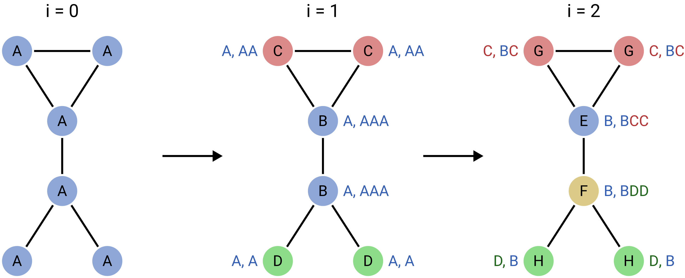

1-Dimensional Weisfeiler-Lehman Colorings
Core Idea: Characterize graphs via multisets of colors.
G
E
G
F
H
H
Refinement:

Slide 14
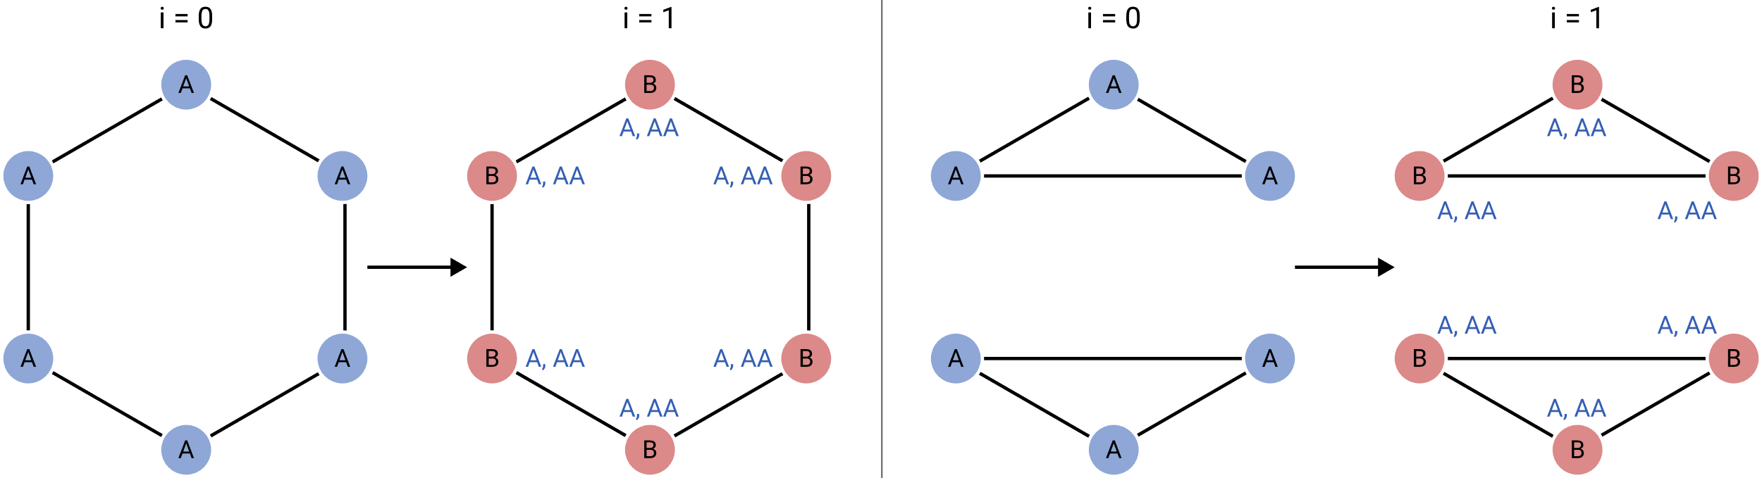
1-Dimensional Weisfeiler-Lehman Colorings
Limitations of 1-WL: Regular graphs & cycle detection.

Slide 15
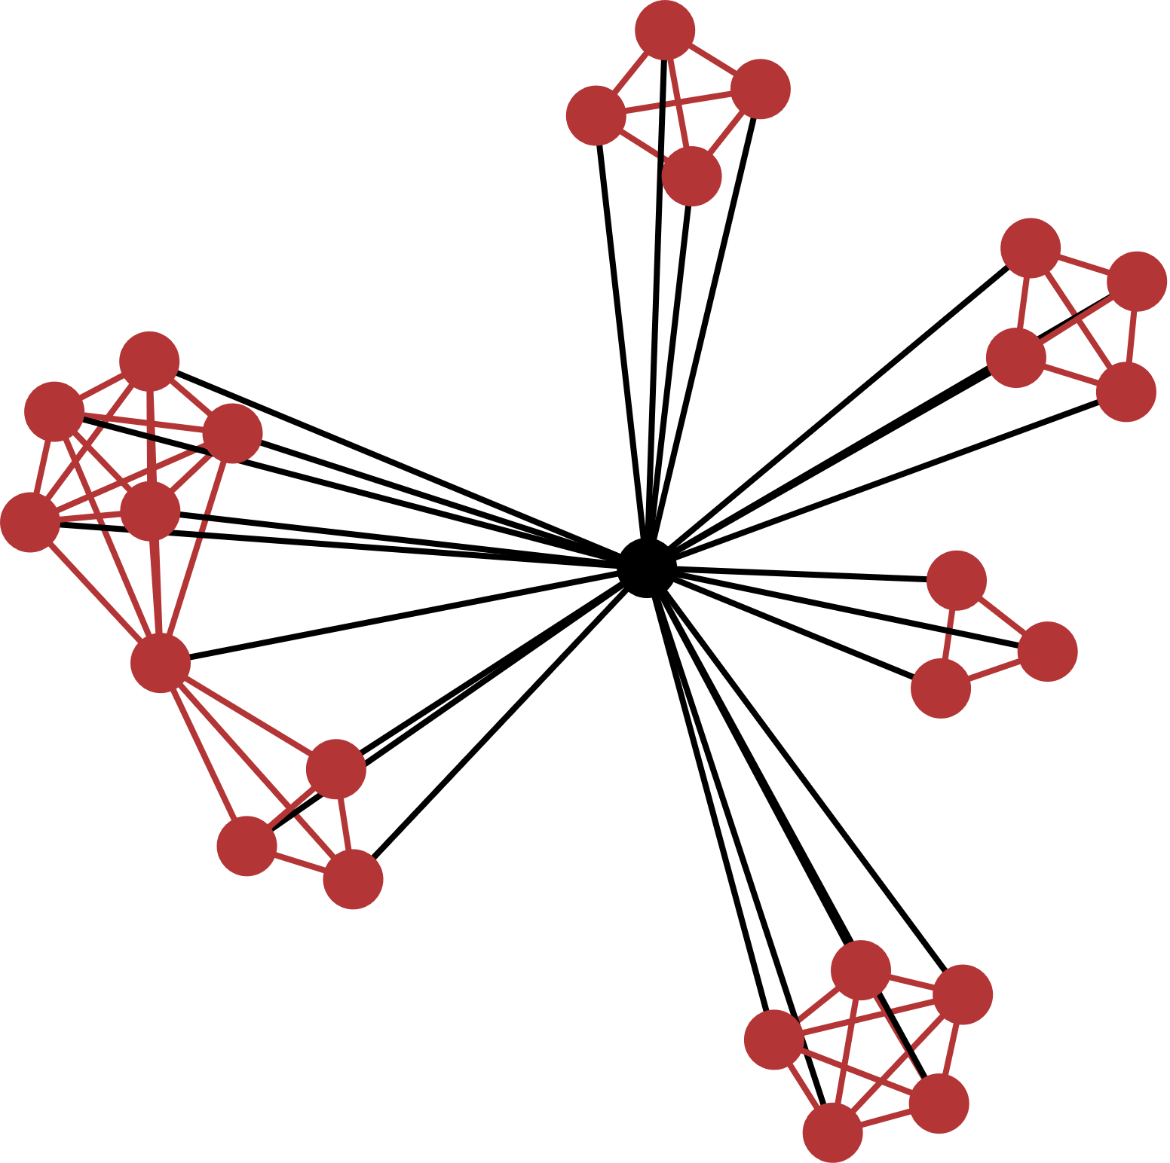
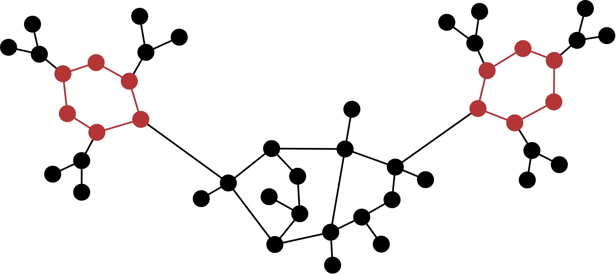

1-Dimensional Weisfeiler-Lehman Colorings
Limitations of 1-WL: Regular graphs & cycle detection.
Molecules: Carbon rings
Social networks: Clustering coefficient
$∝$ triangle count

Slide 16
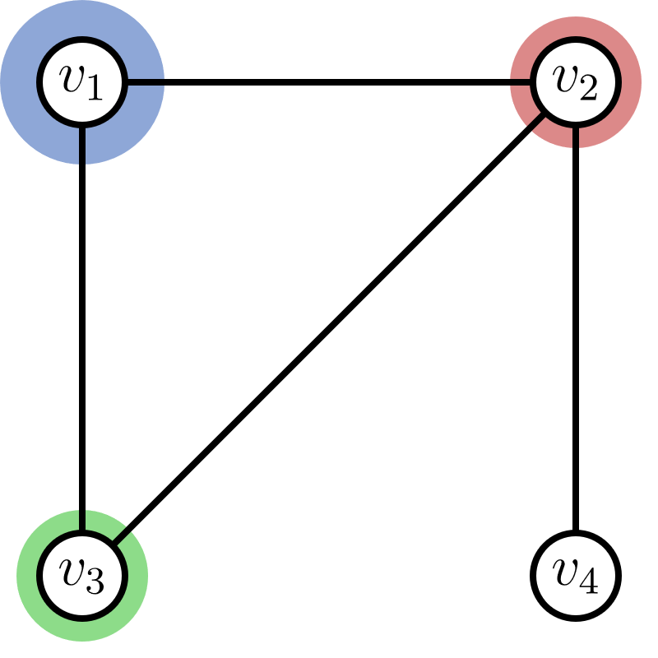
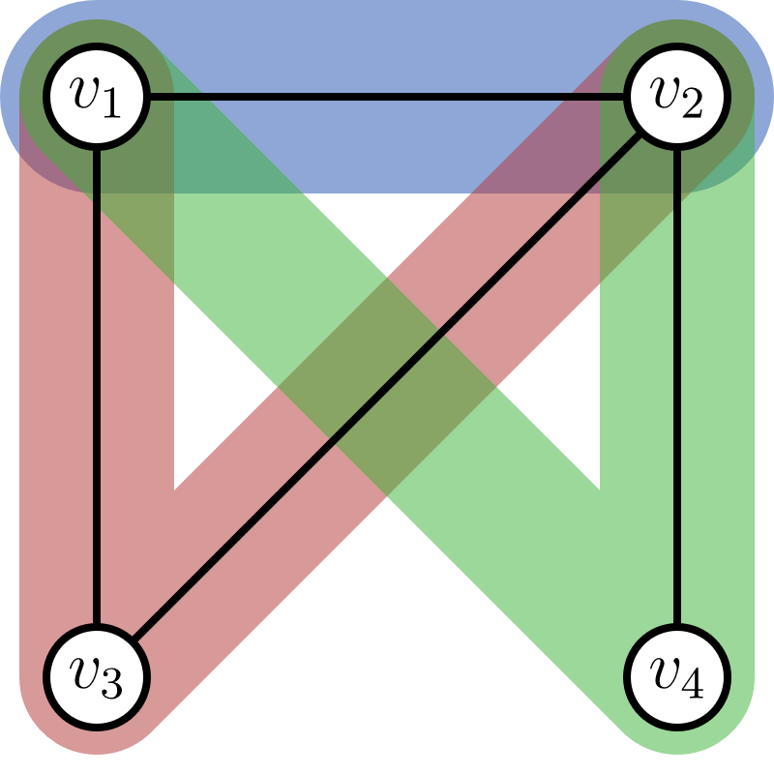
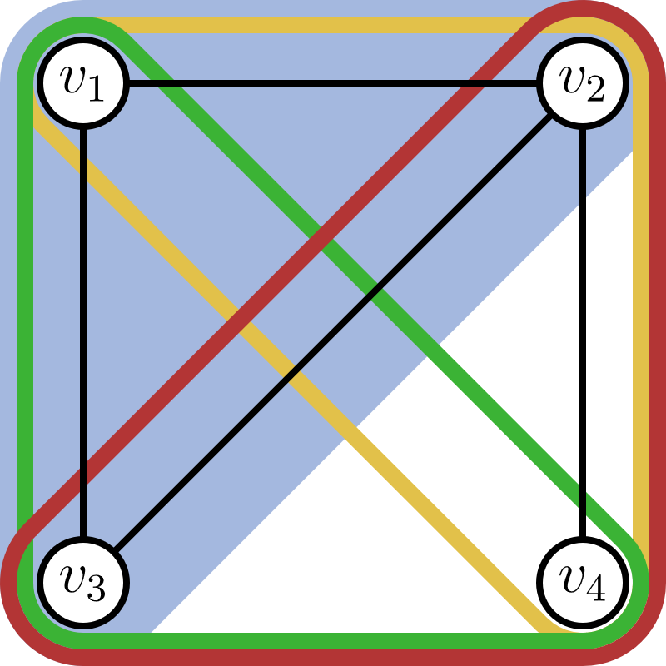


$k$-Dimensional Weisfeiler-Lehman Colorings
Discriminative power & runtime cost
1-WL
2-WL
3-WL
vertex colors
vertex pair colors
vertex triple colors
Refinement:

Slide 17
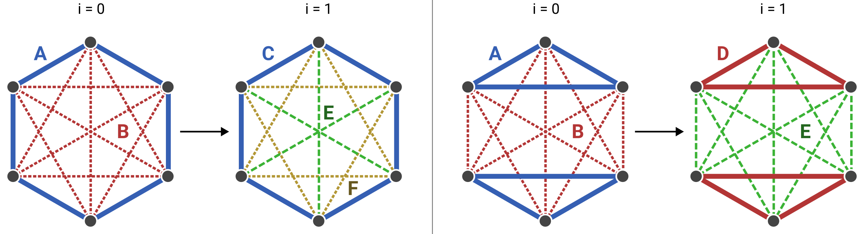
2-Dimensional Weisfeiler-Lehman Colorings
1-WL:
2-WL:

Slide 18

2-Dimensional Weisfeiler-Lehman Colorings
one 6-cycle
two 3-cycles
2-WL counts cycles of length $≤7$

Slide 19
LTA Formulation of Existing GC/GR Approaches
Graph Embeddings & Kernels
Graph Neural Networks
Theoretical foundations:
Weisfeiler-Lehmann colorings
ü

Slide 20
LTA Formulation of Graph Embeddings & Kernels
Fingerprint embeddings
WL subtree kernel
2-LWL kernel
graph2vec
WL shortest-path kernel
2-GWL kernel
…

Slide 21
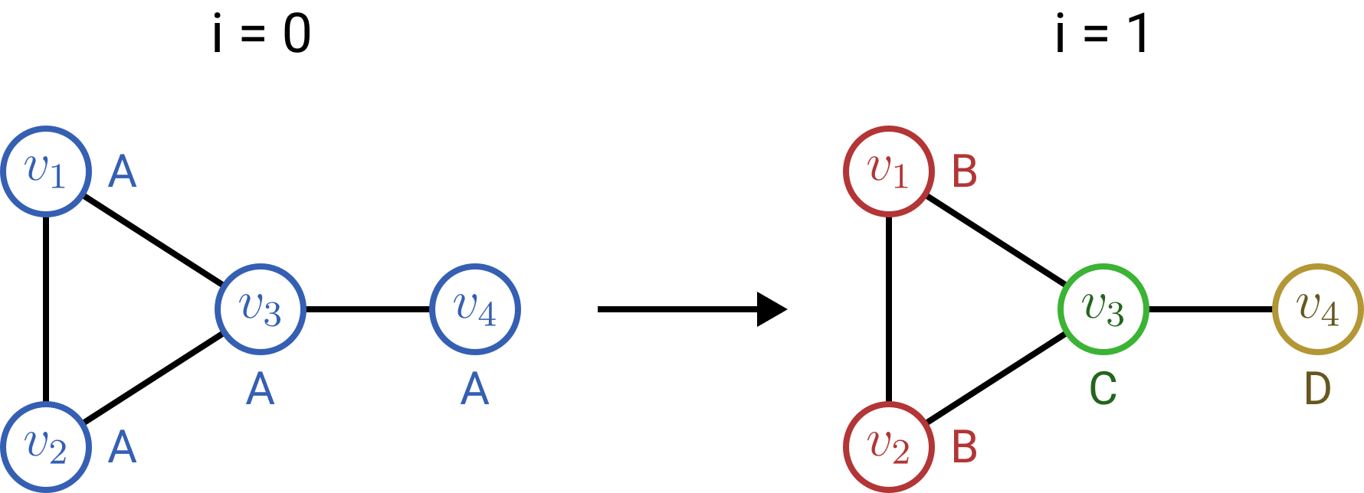
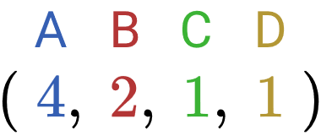
WL Subtree Kernel
1-WL color embedding:

Slide 22
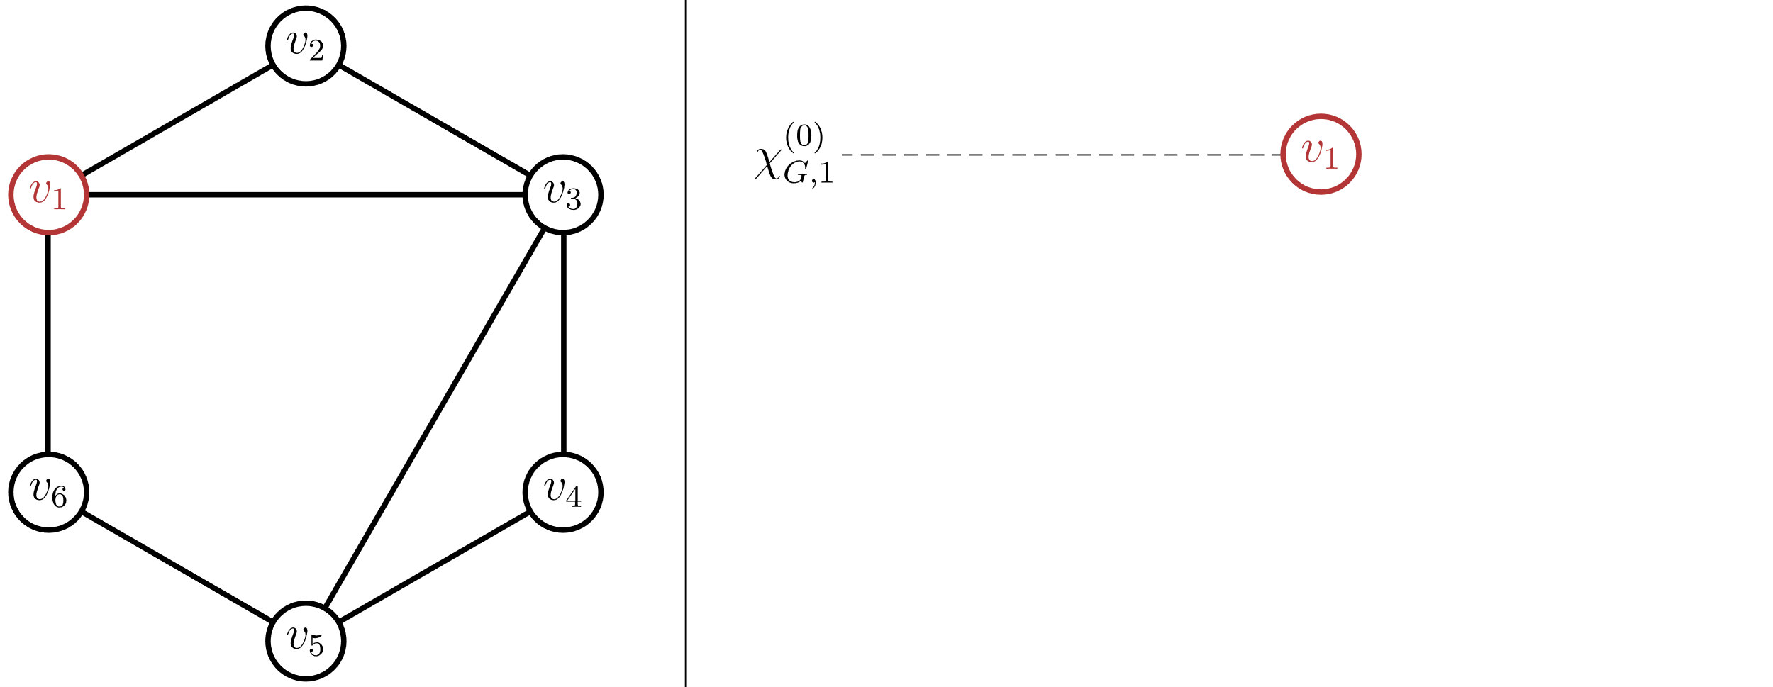
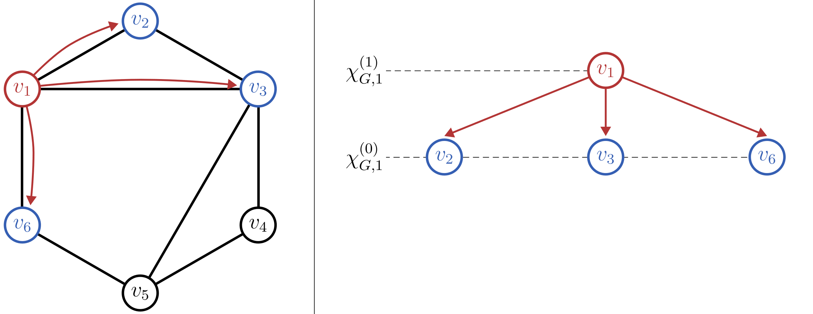
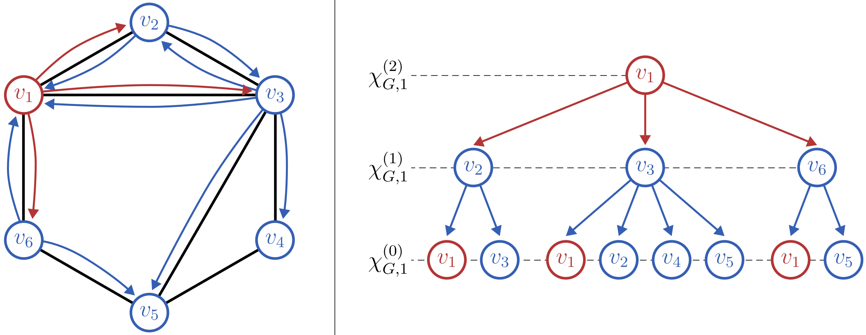
WL Subtree Kernel
Each WL color corresponds to a subtree

Slide 23
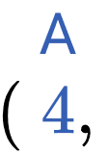


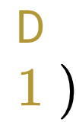
WL Subtree Kernel
1-WL color embedding:

Slide 24
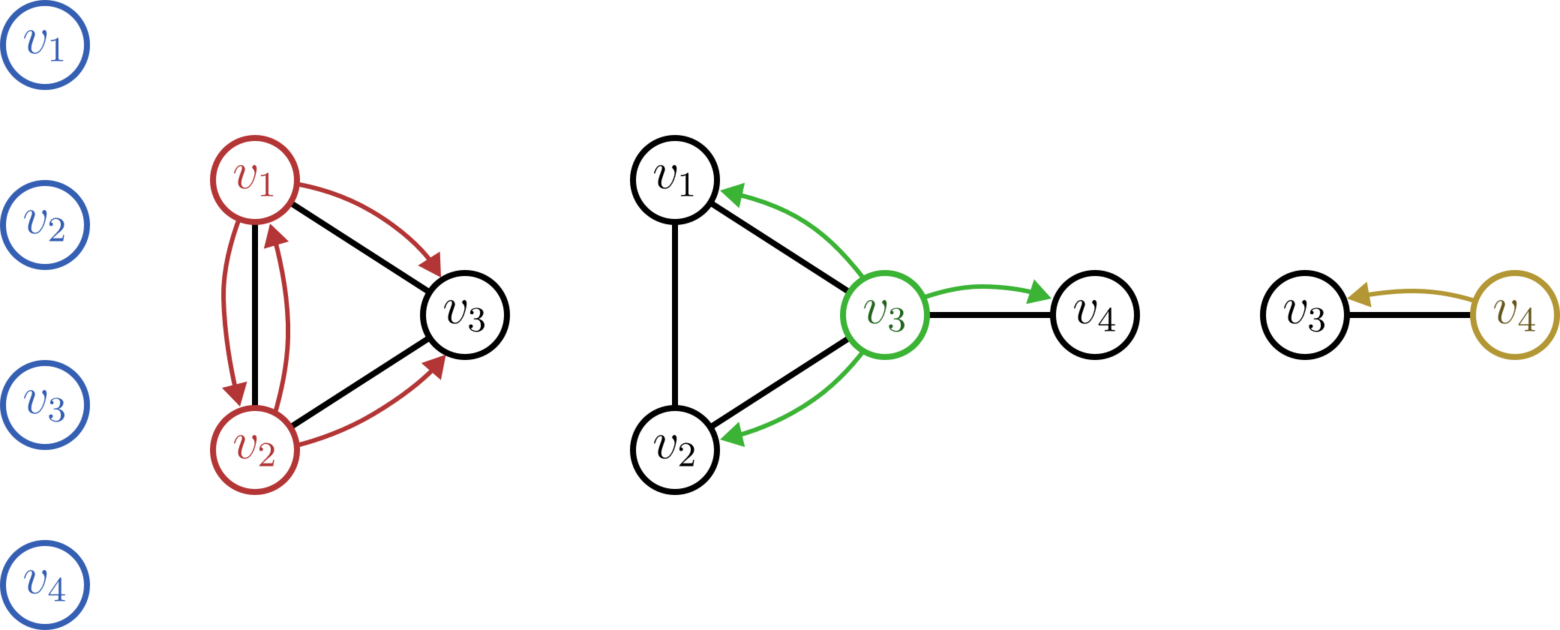
WL Subtree Kernel
1-WL color embedding:

Slide 25
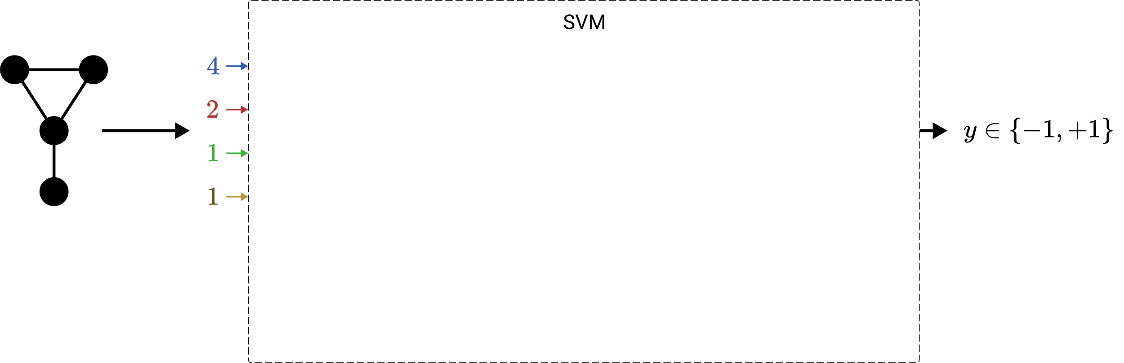
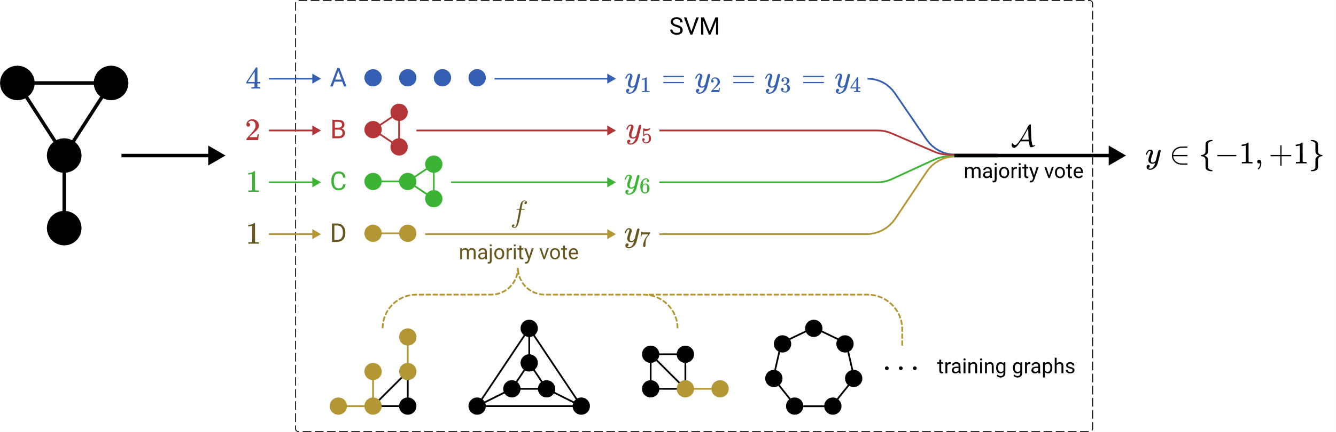

LTA Formulation of Graph Embeddings & Kernels

Slide 26
LTA Formulation of G​raph Embeddings & Kernels
Fingerprint embeddings
2-LWL kernel
LTA-like
Fingerprint embeddings
WL subtree kernel
2-LWL kernel
graph2vec
WL shortest-path kernel
2-GWL kernel
non-LTA
graph2vec
WL shortest-path kernel
2-GWL kernel

Slide 27
Research Questions
LTA
What is a general definition of LTA?
How does LTA relate to existing GC/GR methods?
What are shortcomings of existing GC/GR methods? How can they be fixed?
ü
?
G​raph Embeddings & Kernels
Graph Neural Networks

Slide 28
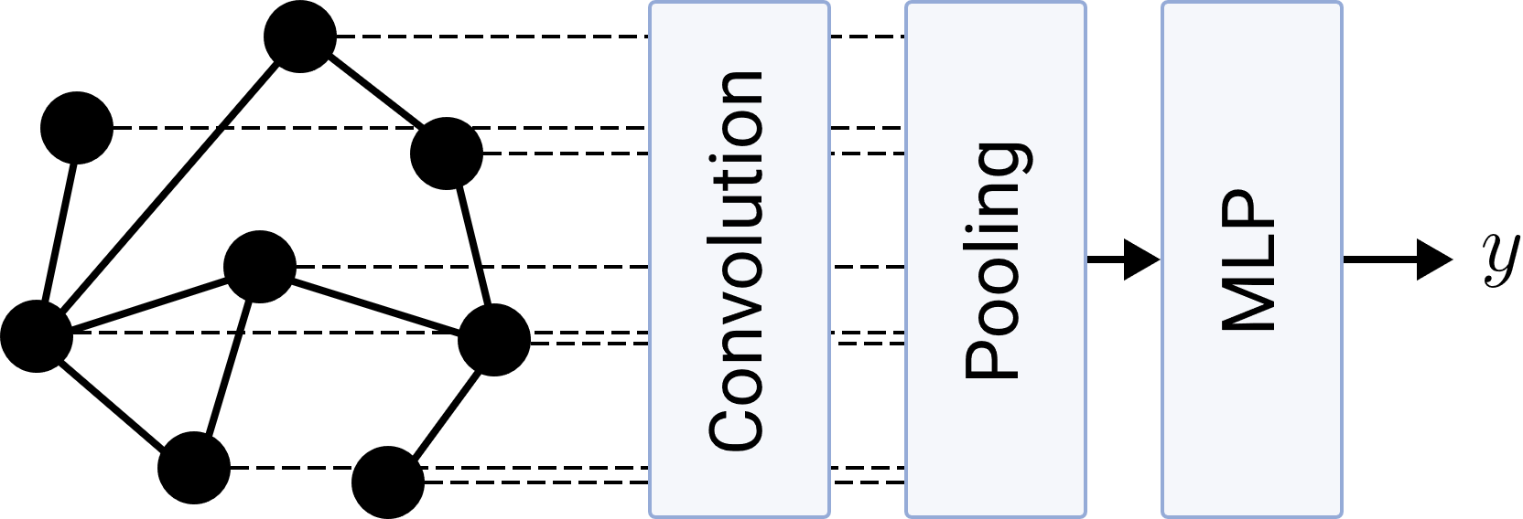
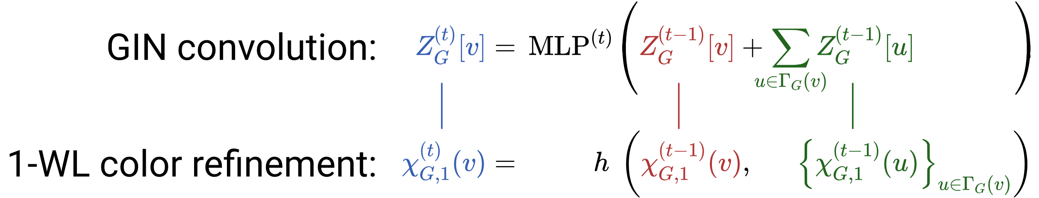
LTA Formulation of Graph Neural Networks
mean
max
self-attention
OWA
…

Slide 29
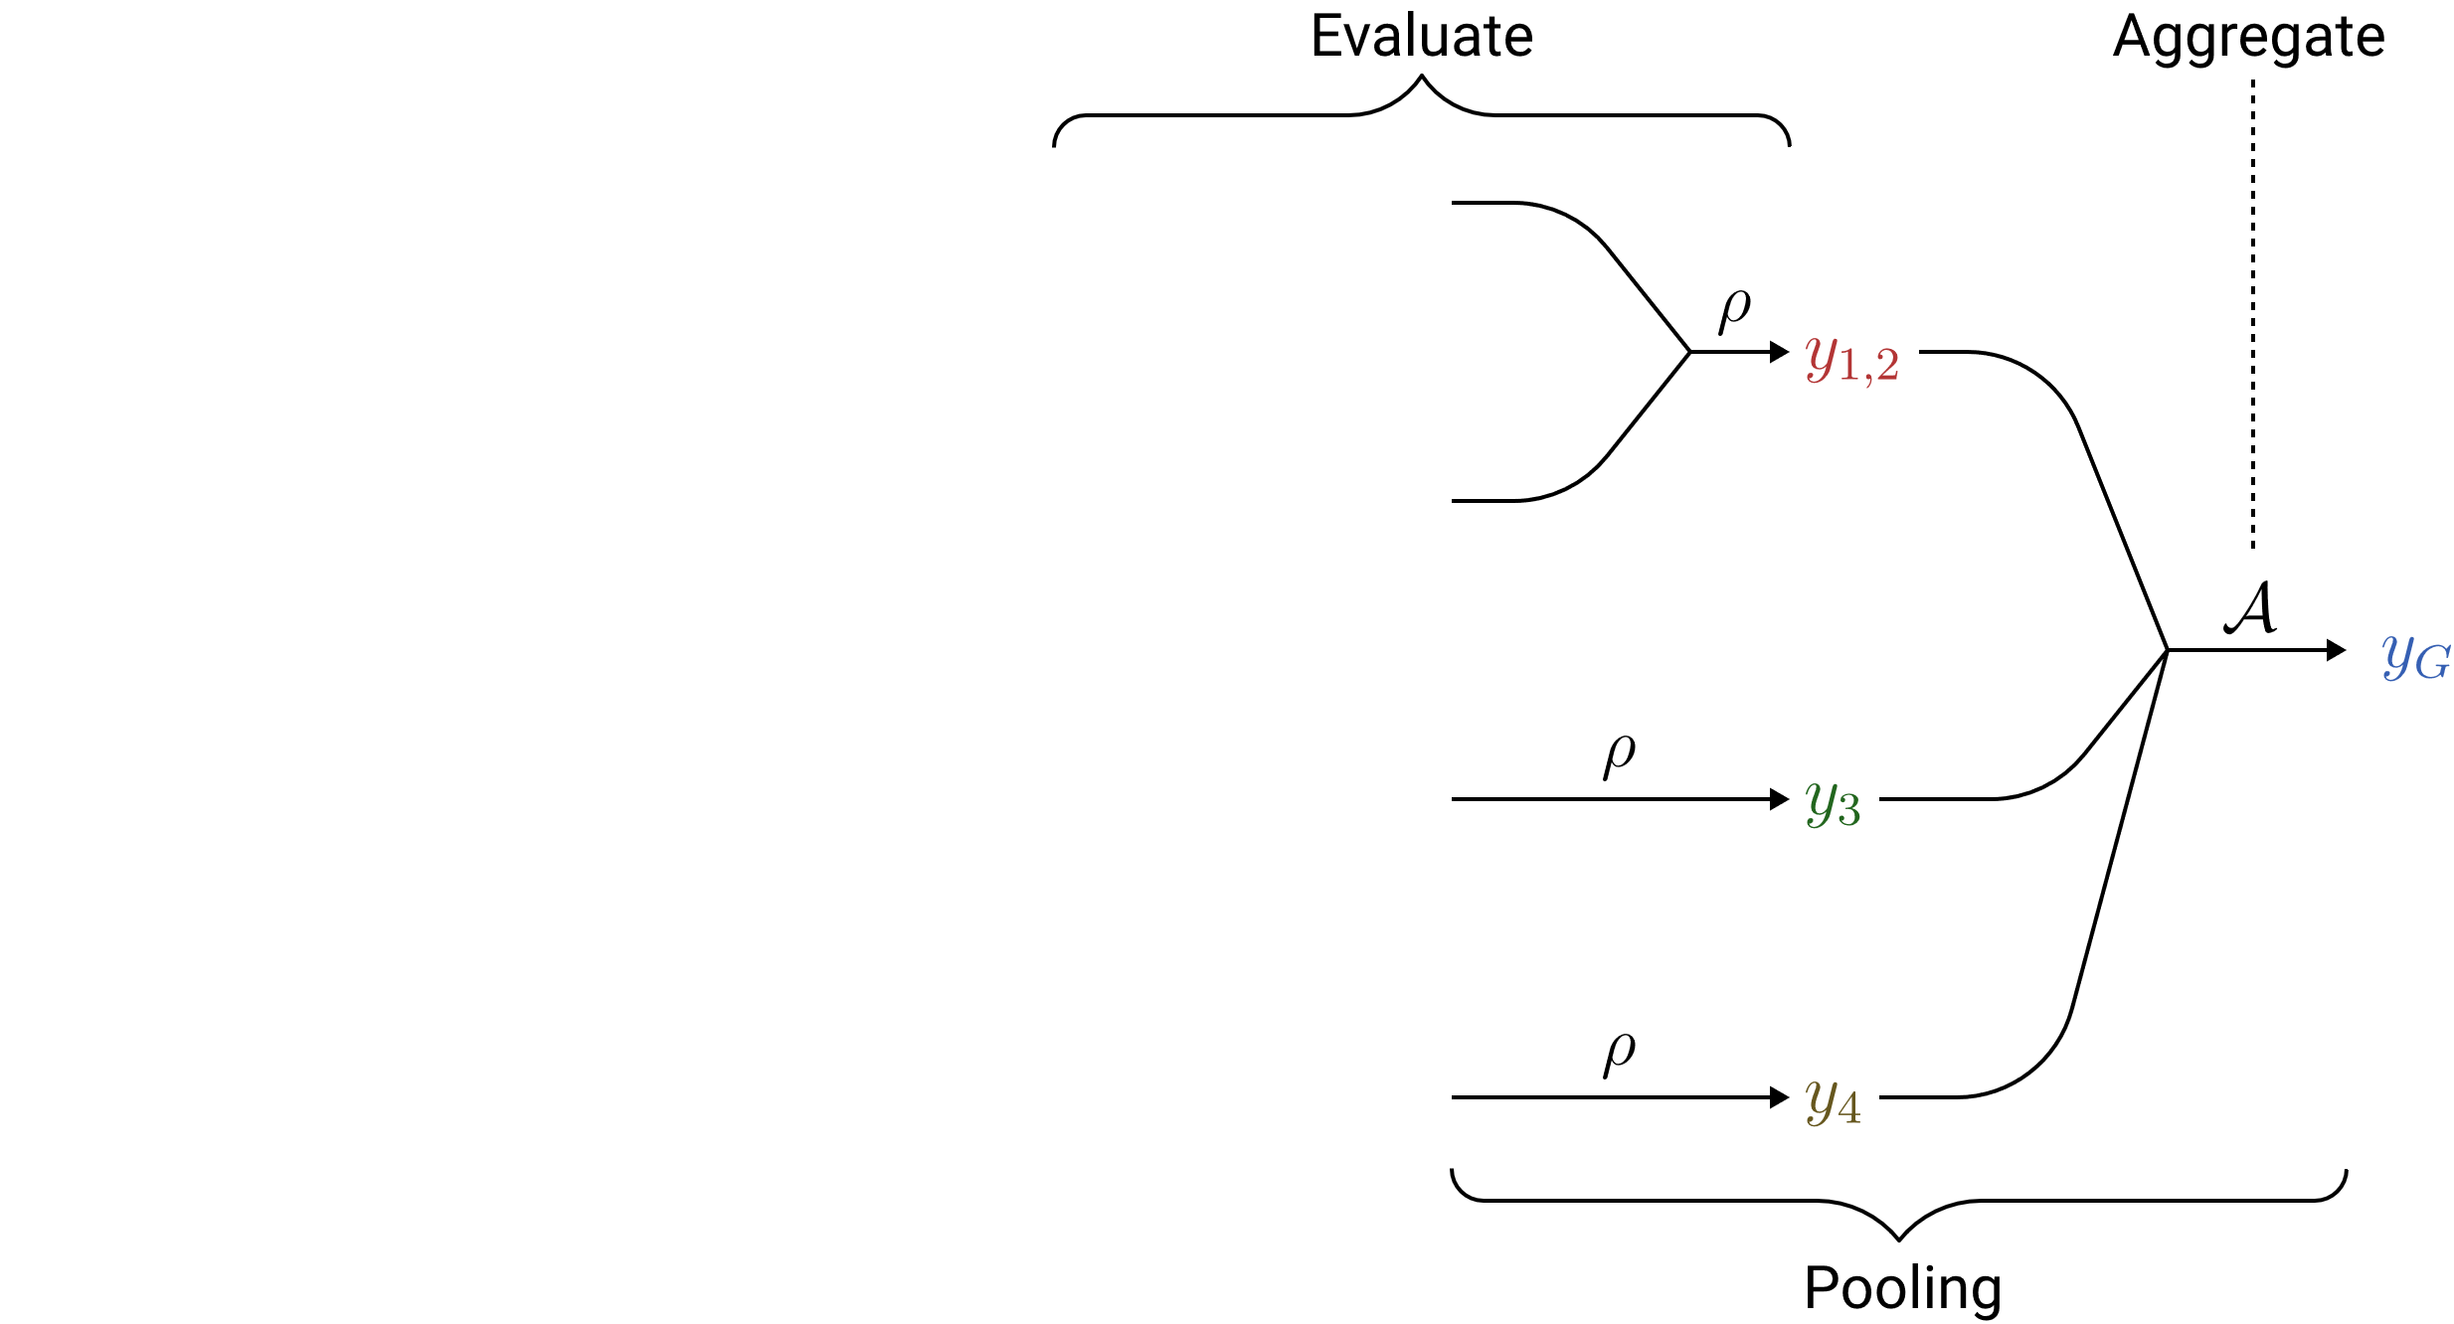
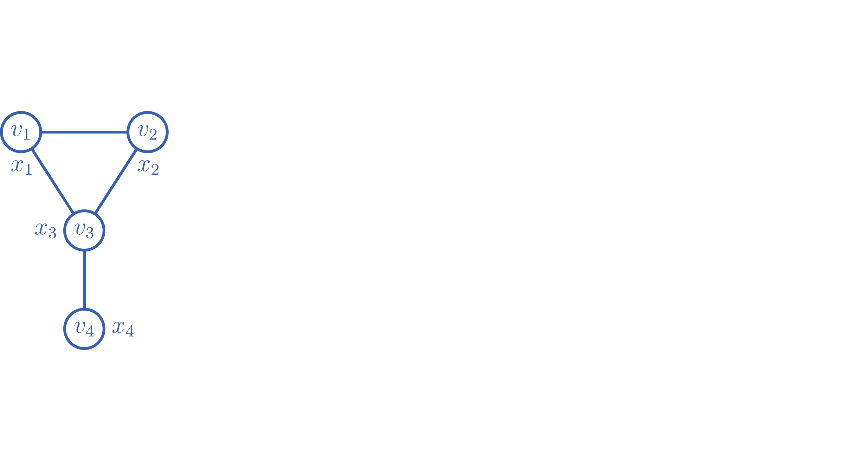
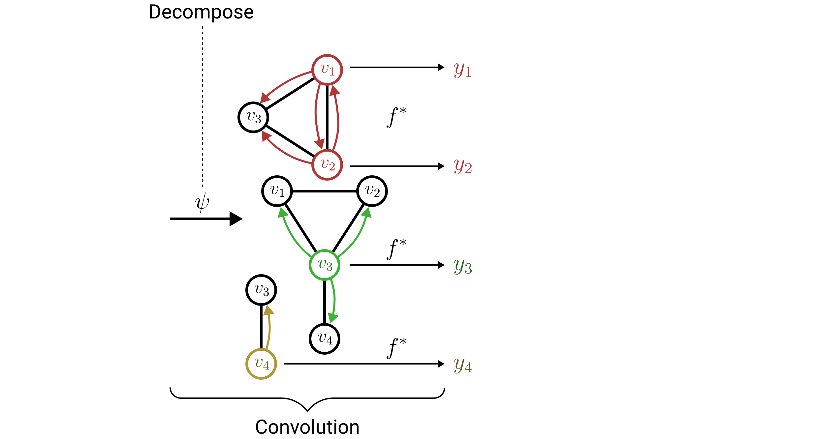
LTA Formulation of Graph Neural Networks
LTA-like
1. Convolution must produce local graph scores
2. Pooling must be associative
e.g. mean or self-attention pooling

Slide 30
Research Questions
LTA
What is a general definition of LTA?
How does LTA relate to existing GC/GR methods?
What are shortcomings of existing GC/GR methods? How can they be fixed?
ü
ü
G​raph Embeddings & Kernels
Graph Neural Networks

Slide 31
Shortcomings of Existing GC/GR Methods
G​raph Embeddings & Kernels
Graph Neural Networks
Embeddings freely determine decomposition
Fixed subtree decomposition
Fixed majority vote evaluation & aggregation
Dynamic MLP-based evaluation
& freely choosable aggregation

Slide 32
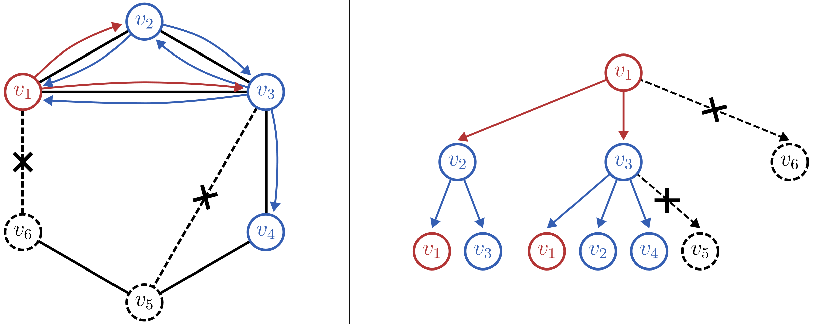
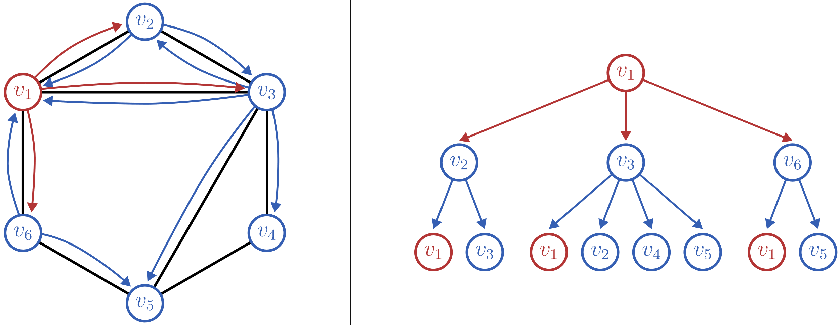
Learning Subtree Constituents
Idea: Prune subtrees via edge filtering

Slide 33
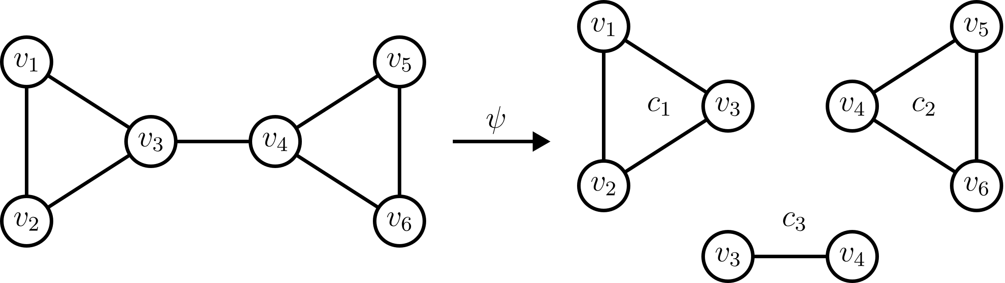
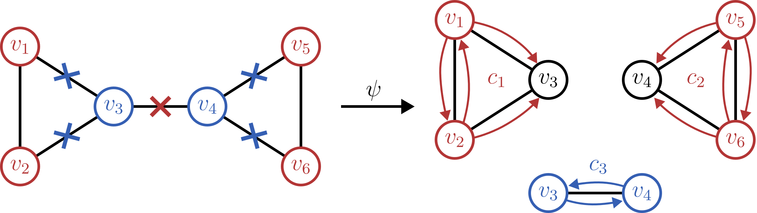
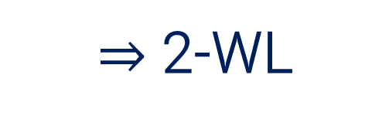

Learning Subtree Constituents
Edge filter requires informative edge feature vectors
$⇒$ 2-WL
$⇒$ More flexible decompositions

Slide 34
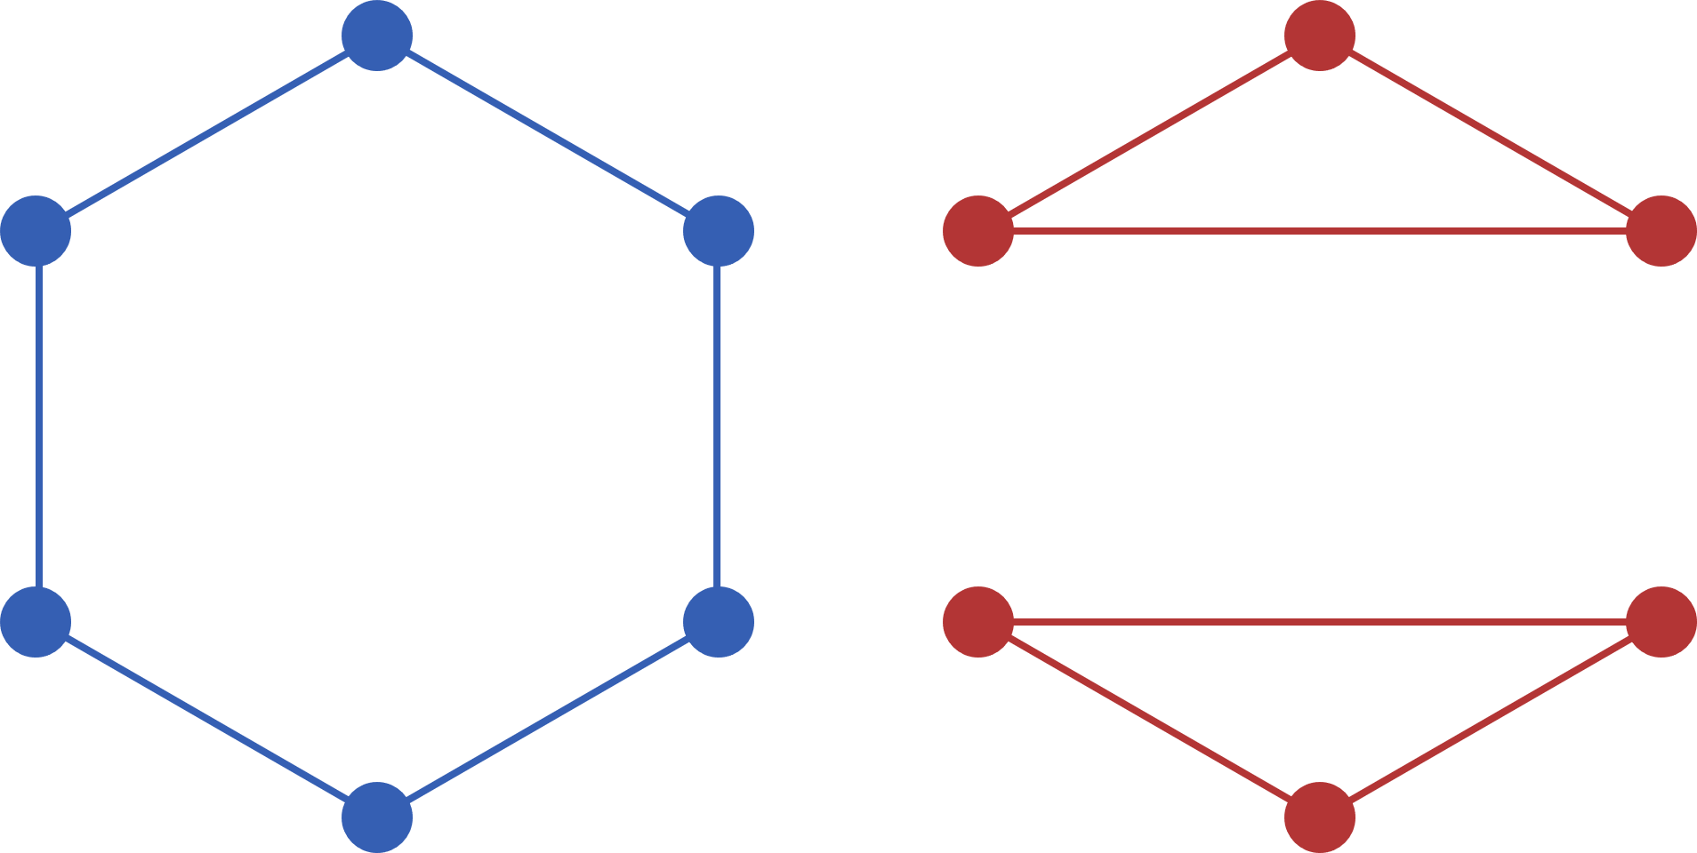

A 2-WL Inspired Convolution Operator
Problem: Existing graph convolutions are bounded by 1-WL
$⇒$ A novel 2-WL convolution operator is proposed
LTA Motivation:
Flexible decompositions
General Motivation:
Discriminative & computational power
& cycle detection
regular graphs

Slide 35

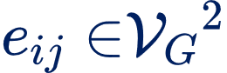
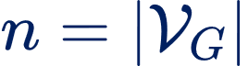

A 2-WL Inspired Convolution Operator
2-WL
One color per vertex pair
neighbors per vertex pair
time complexity for each refinement
Solution: Simplify refinement using sparsity

Slide 36






A 2-WL Inspired Convolution Operator
neighborhood radius
only existing edges
full 2-WL coloring
refinement complexity
$$≤$$
$$≪$$
max vertex degree

Slide 37



A 2-WL Inspired Convolution Operator
1. Can simulate the existing 1-WL bounded GNNs
$⇒$ 1-WL-GNNs $⊂$ 2-WL-GNNs
2. Higher discriminative & computational power than 1-WL

Slide 38
A 2-WL Inspired Convolution Operator
2-WL-GNNs are a starting point for the
2-WL-GNNs provide a solution for the
LTA Motivation:
Flexible decompositions
General Motivation:
Discriminative & computational power
& cycle detection

Slide 39
Research Questions
LTA
What is a general definition of LTA?
How does LTA relate to existing GC/GR methods?
What are shortcomings of existing GC/GR methods? How can they be fixed?
ü
ü
G​raph Embeddings & Kernels
Graph Neural Networks

Slide 40
Evaluation

